Slide 1

Real Estate Data Analysis using Web Scraping & EDA
Name: Tippaluri Srinu

Slide 2
What is Web Scraping ? How it works ?
Web Scraping is the process of automatically extracting data from websites using software or scripts.
Instead of manually copying information, scraping tools:
  Collect large volumes of data
  Convert unstructured web data into structured formats like CSV
  Enable automated data analysis
Process Flow:
Request Webpage
Download HTML
Extract Required Data
Store Data
Analyze Data

Slide 3
Objective
To extract real estate property data using web scraping
To automate multi-page data collection
To clean and preprocess unstructured data
To perform Exploratory Data Analysis (EDA)
To analyze pricing patterns and market trends
To visualize insights using Python

Slide 4
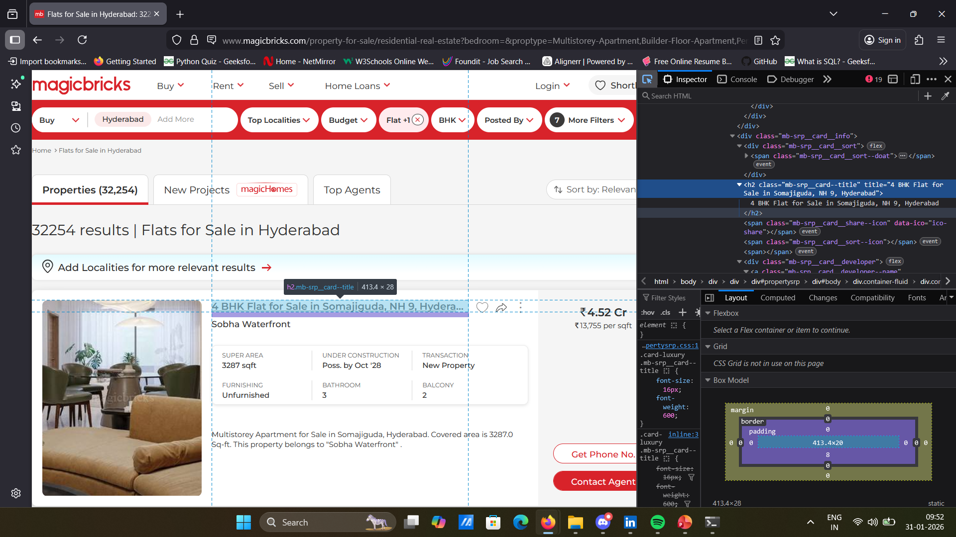
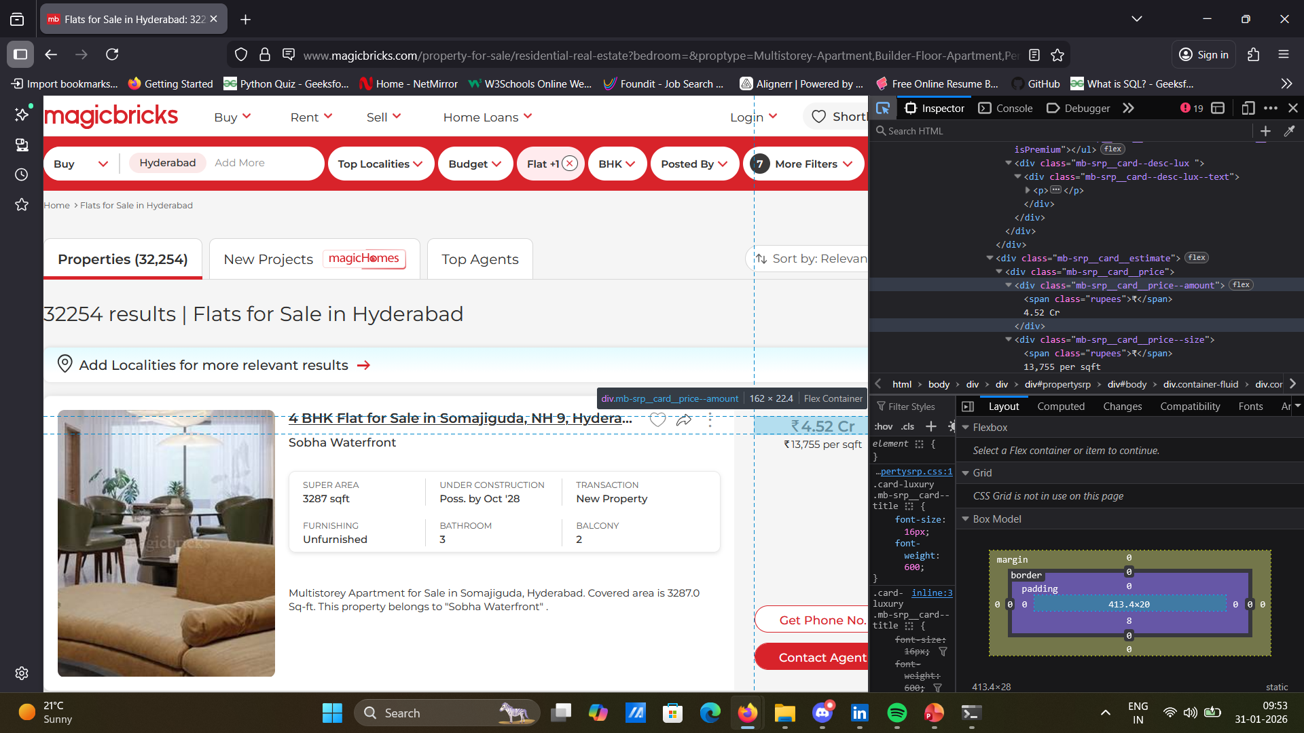
Website
Link - https://www.magicbricks.com/property-for-sale/residential-real-estate?

Slide 5
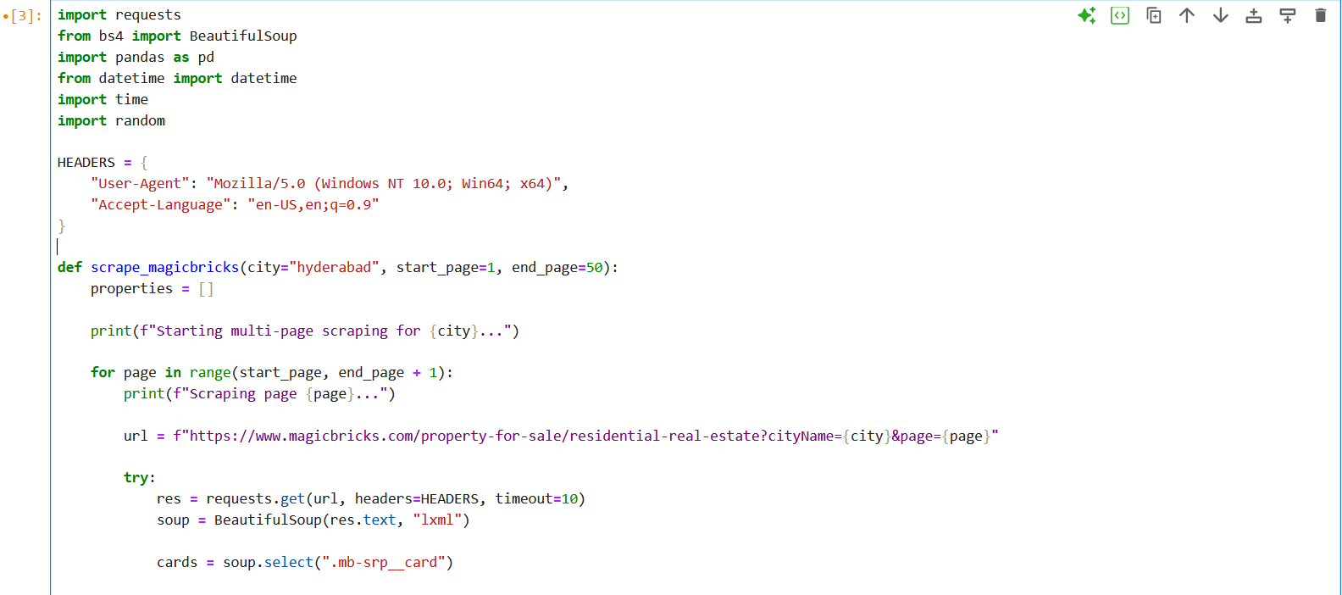
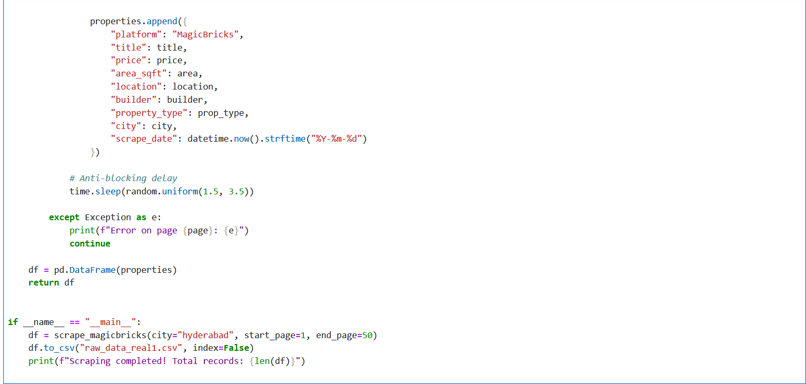
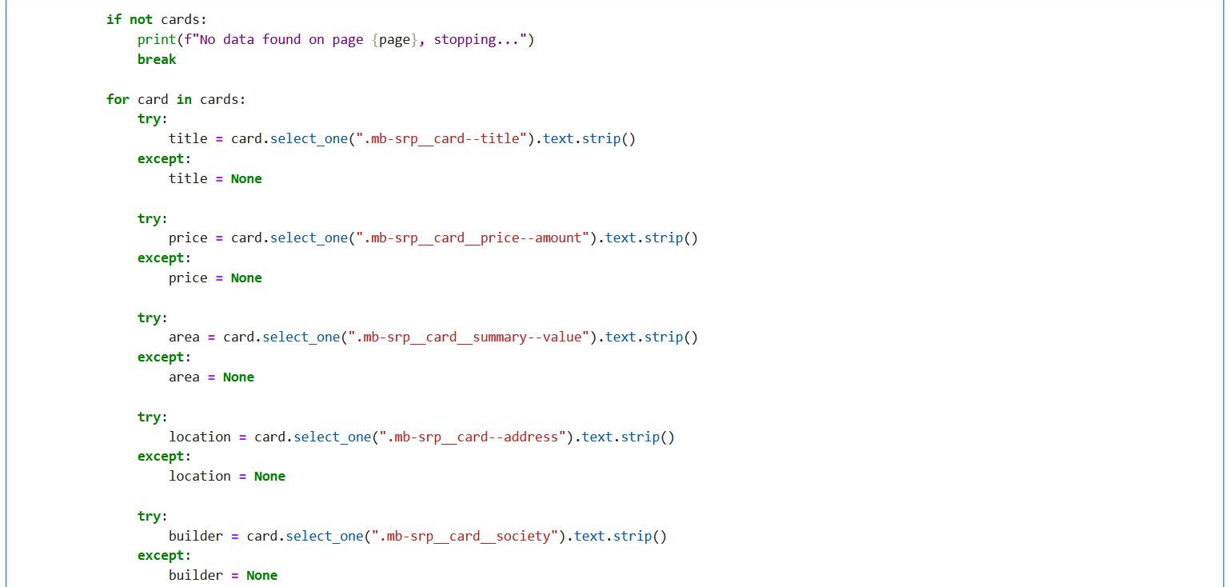
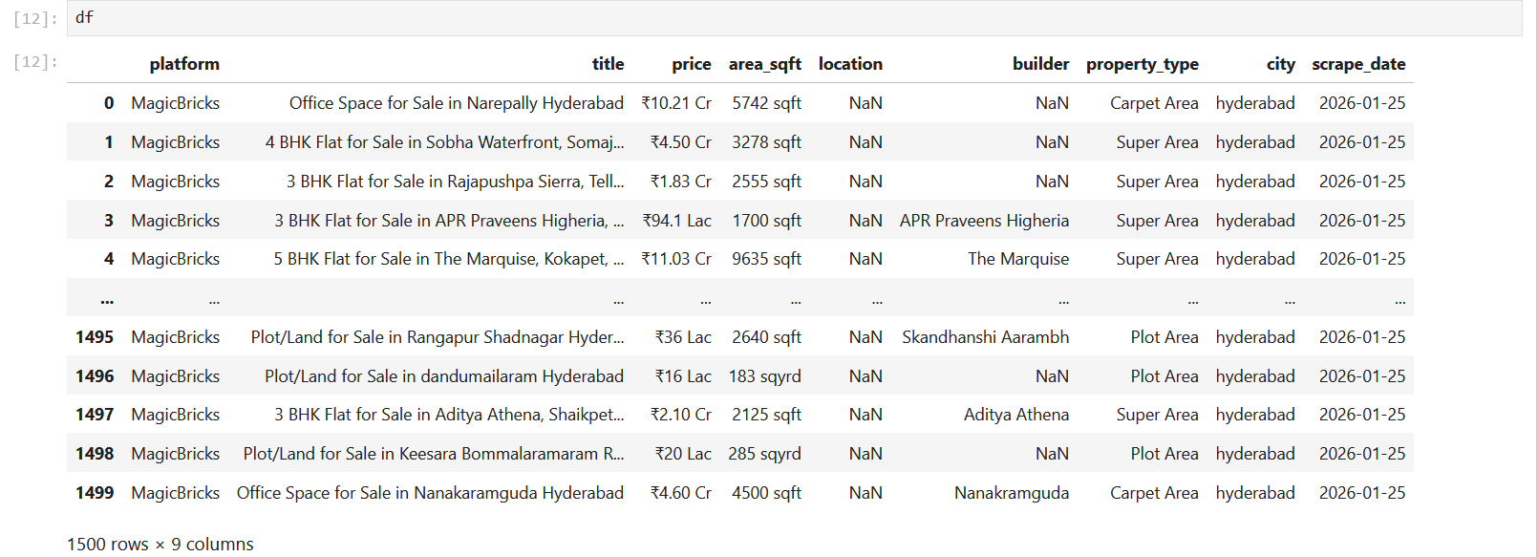
Extracting data from webpage

Slide 6
Data set Overview
The dataset contains ~1500 Records and 9 columns which contains information about Real Estate.
Data Types:
  Categorical Data: platform, tile, location, builder, property_type, city
  Numerical Data: price, area_sqft, scrape_date

Slide 7
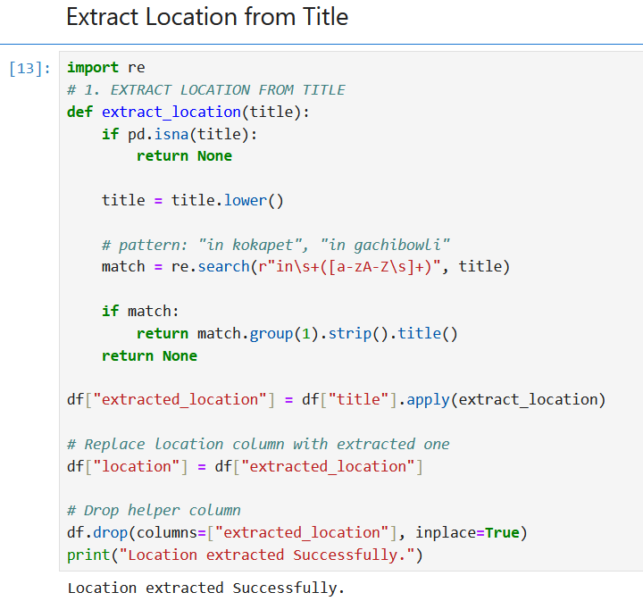
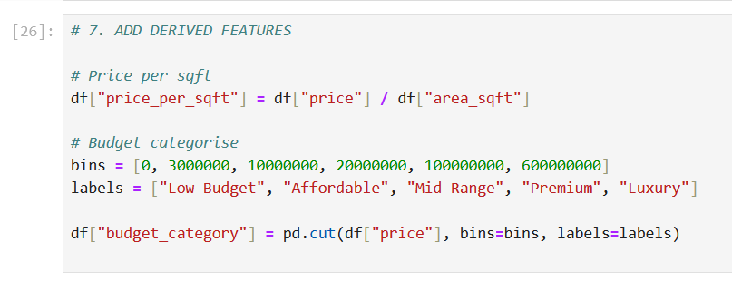
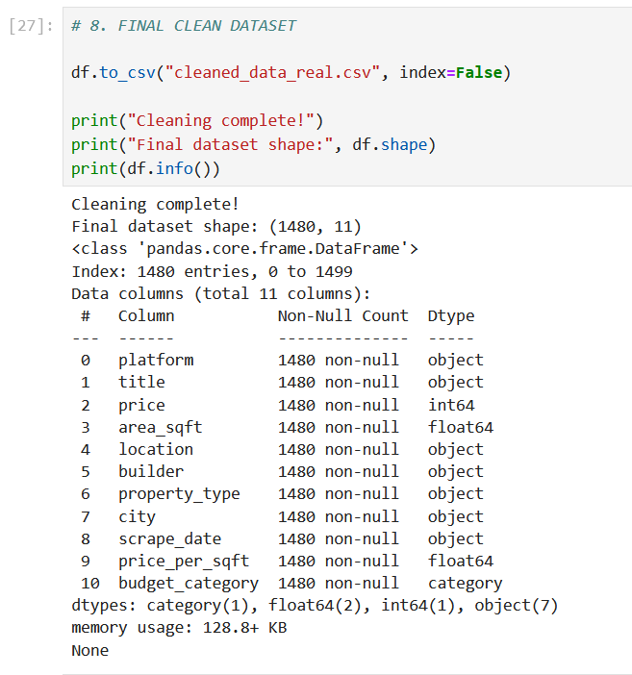
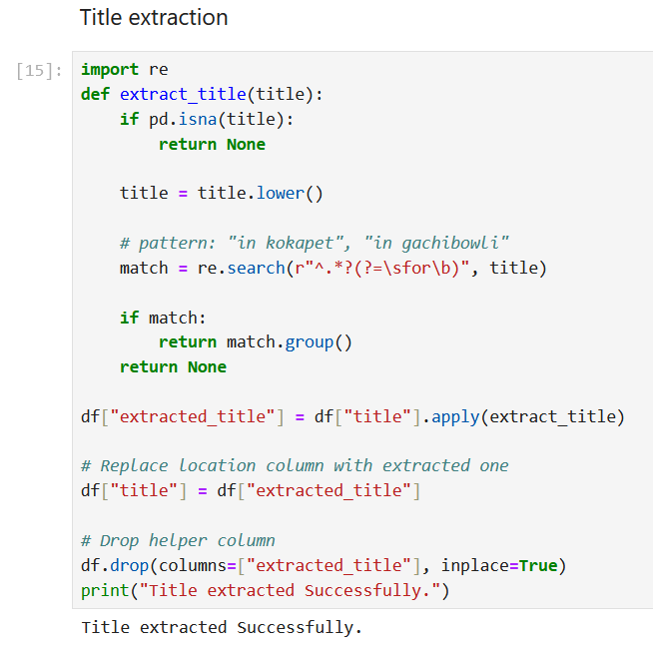

Slide 8
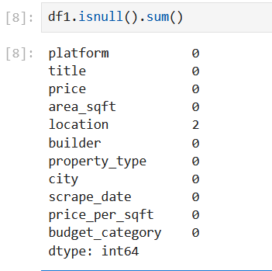
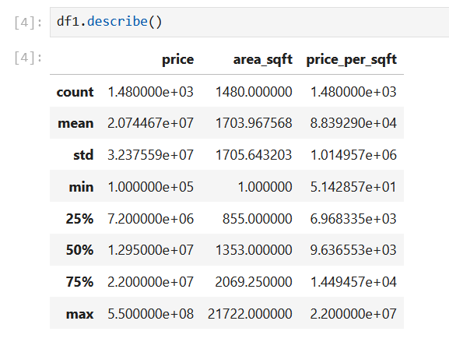
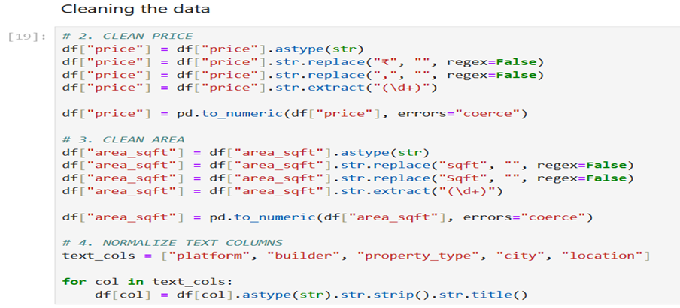
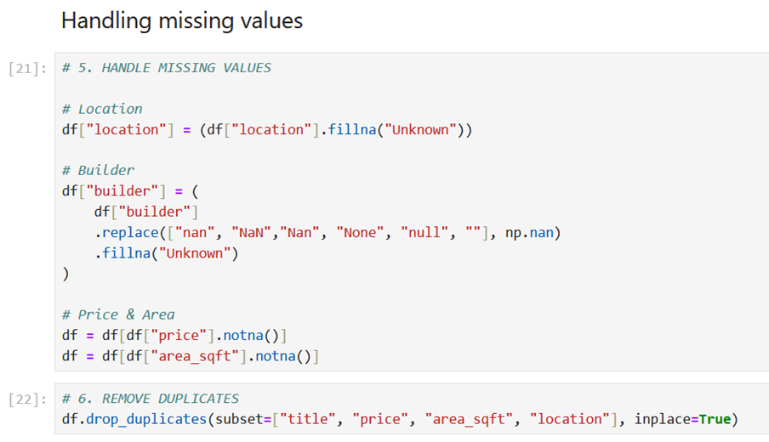
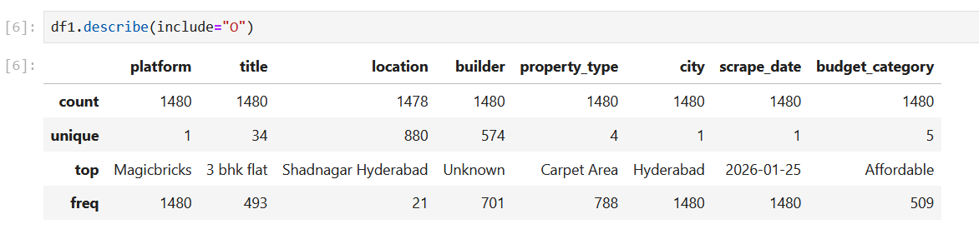
Basic Checks

Slide 9
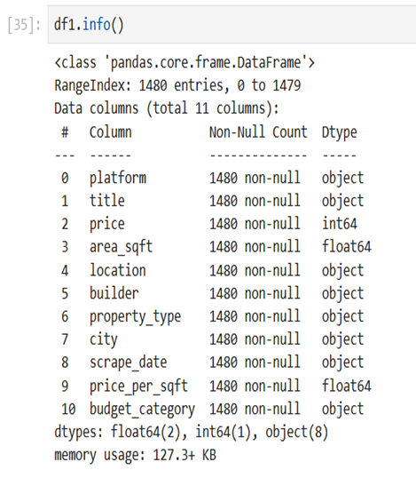
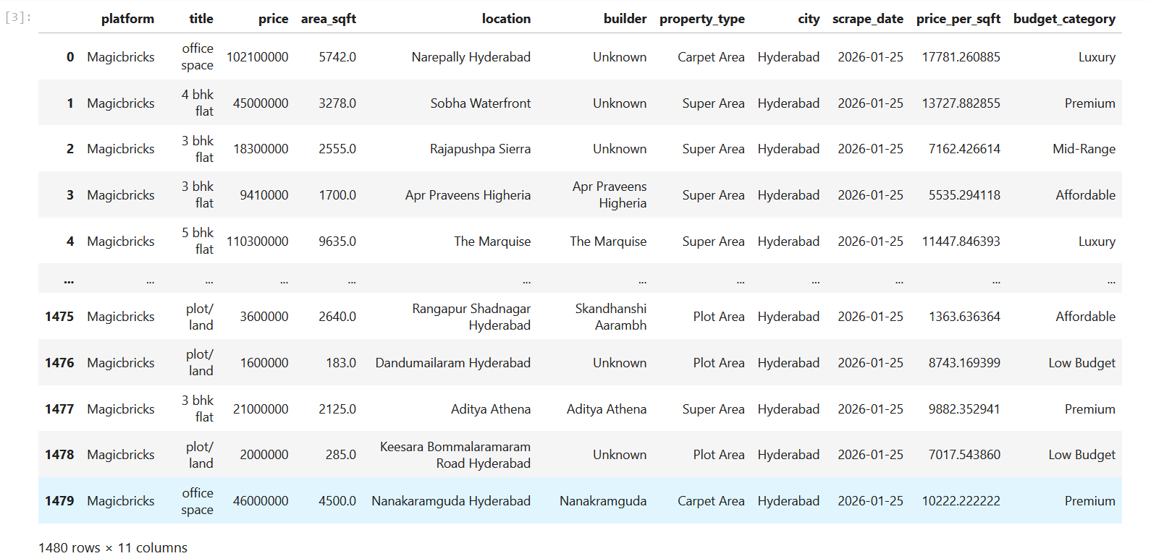
After Preprocessing

Slide 10
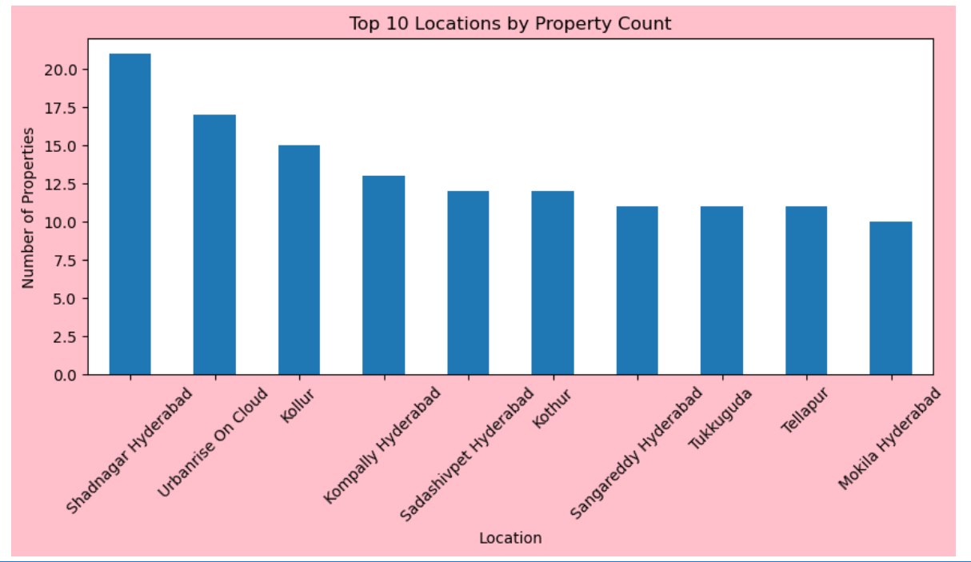
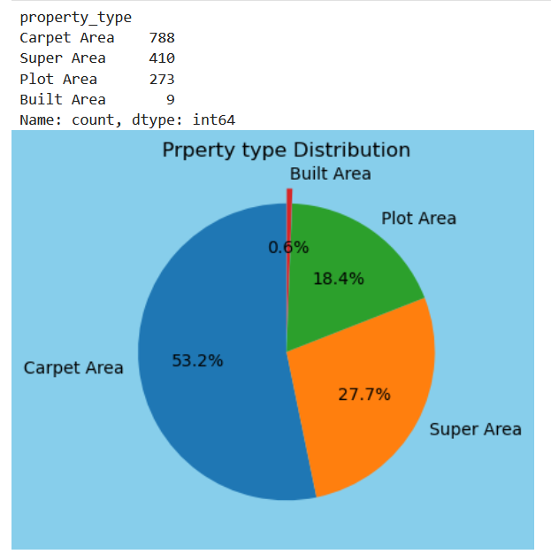
Data Analysis Using Visualizations
Univariate Analysis:
Certain property types dominate the supply, indicating market preference patterns.
Listings are concentrated in specific locations, showing demand clustering in major residential zones.

Slide 11
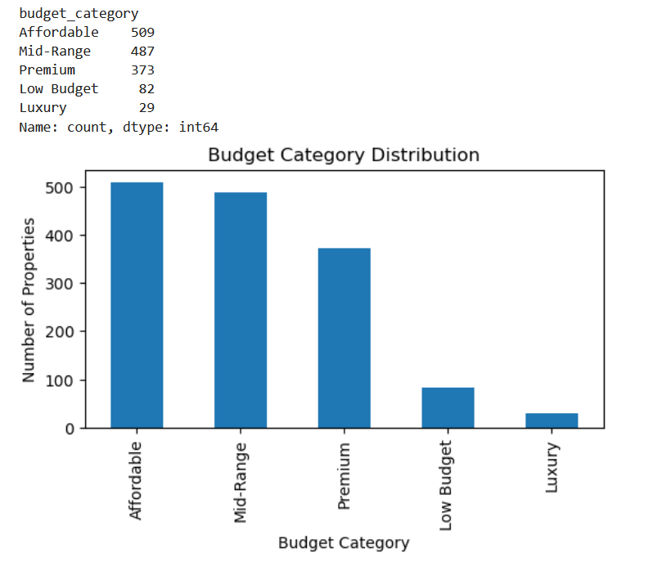
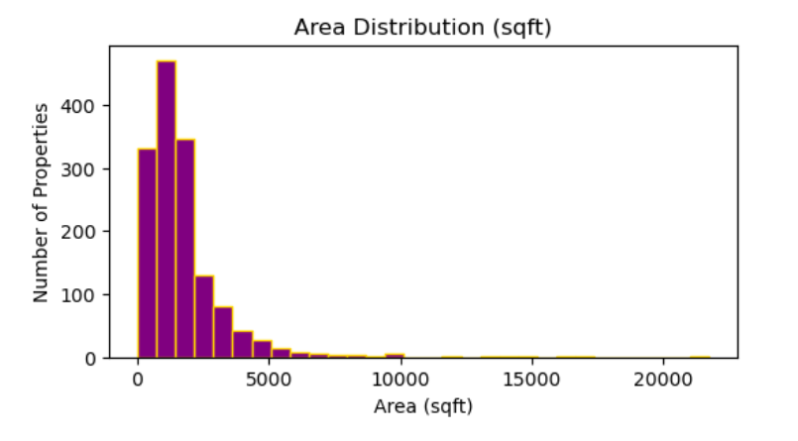
The majority of listings fall into the Affordable, Mid-Range, and Premium categories, while Luxury properties form a smaller segment, indicating a market dominated by mid-income and upper-mid-income housing.
Most properties have moderate built-up area, showing standard residential configurations dominate the market.

Slide 12
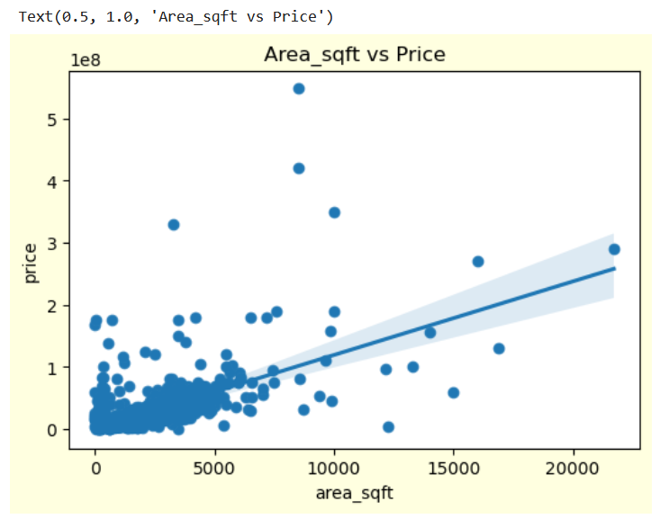
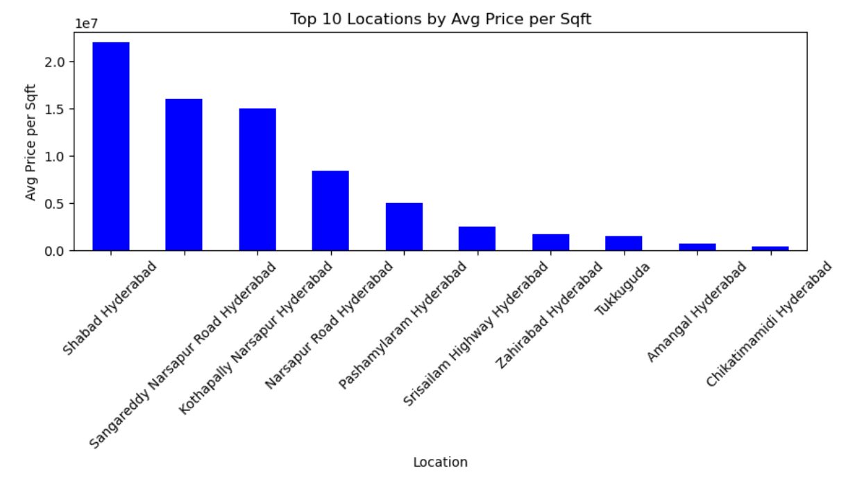
Bivariate Analysis:
There is a positive relationship between area and price as area increases, property price generally increases.
High price-per-sqft locations represent premium urban zones and high-demand residential areas.

Slide 13
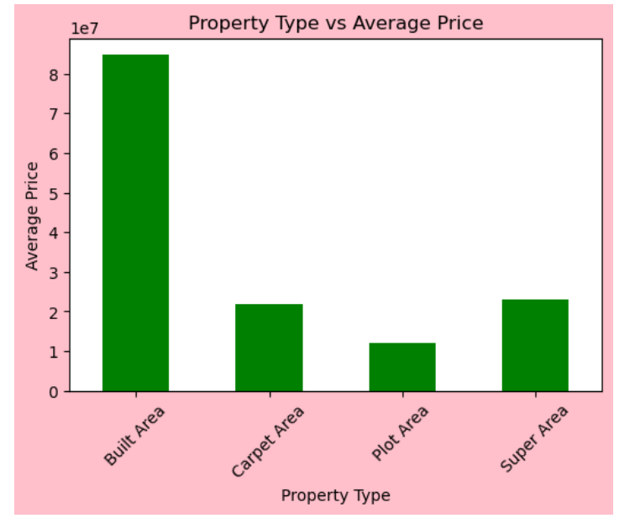
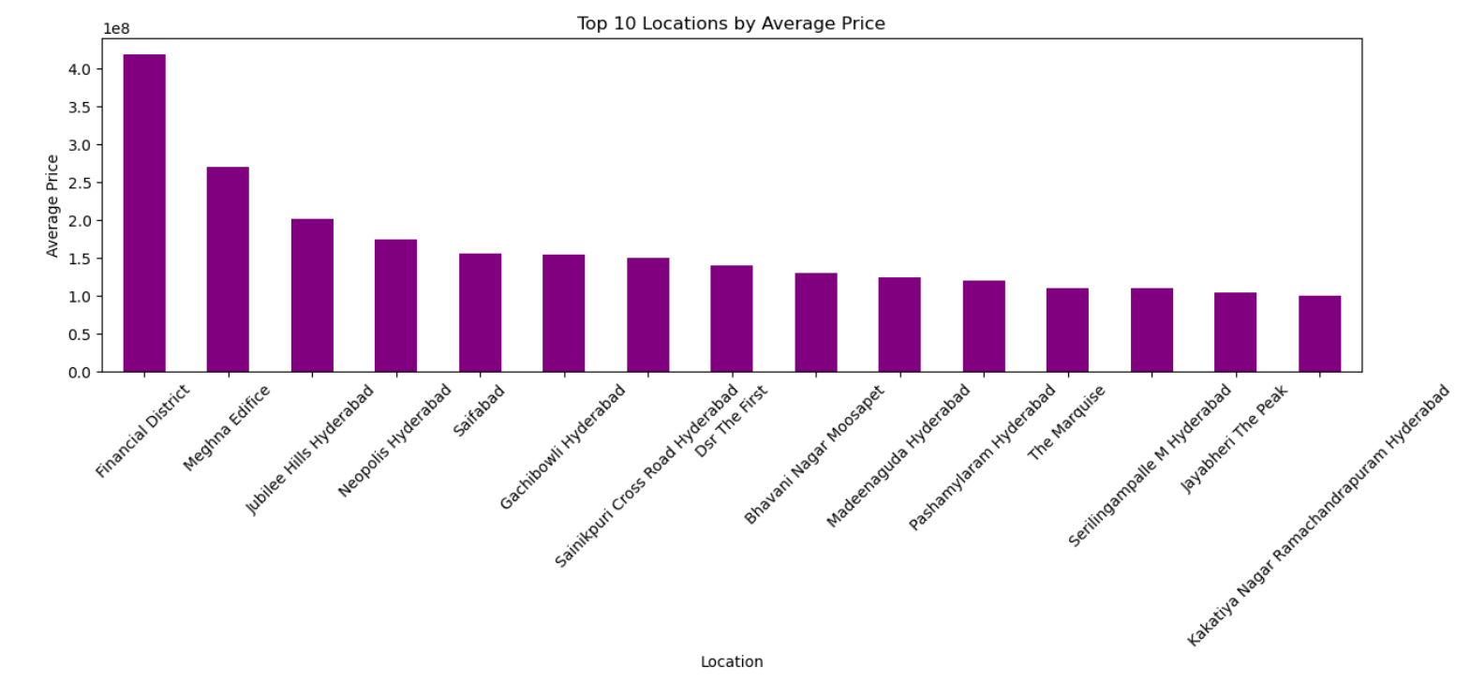
Different property types show clear price variation, reflecting value differentiation by property category.
Certain locations command higher average prices, indicating premium residential zones.

Slide 14
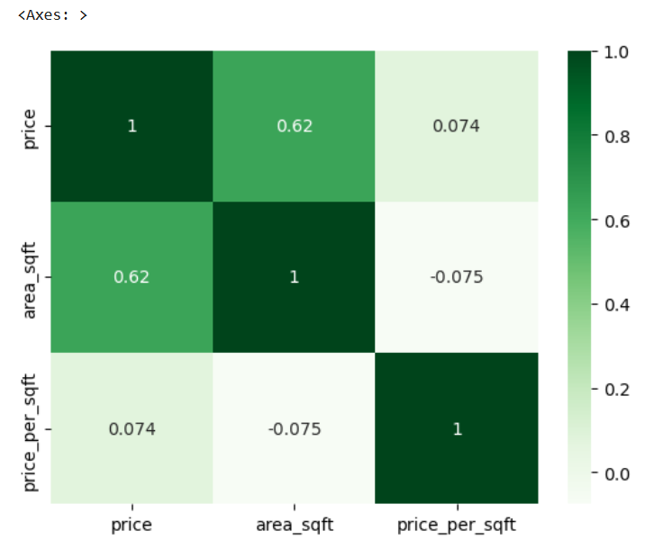
Multivariate Analysis:
The heatmap shows that price strongly depends on area, while price per square foot is largely independent of size, indicating that location and demand play a more important role in determining unit pricing.

Slide 15
Conclusion
This project successfully demonstrates the use of web scraping to collect real estate data and convert unstructured web information into a structured dataset. The data was cleaned, processed, and analyzed using Python-based exploratory data analysis techniques. Key market trends, pricing patterns, and location-based insights were identified through visual analysis. Overall, the project highlights the practical application of data analytics concepts in an academic context.
The project can be extended by collecting data from multiple real estate platforms to improve coverage and accuracy. Integration with databases and automated data pipelines can enable continuous data updates. Advanced analytics techniques such as predictive modeling and AI-based price prediction can be implemented. In the future, this system can evolve into a complete real estate intelligence and recommendation platform.
Future Scope

Slide 16

THANK YOU

